Slide 1

Short Learning Programmes
Memorandum of Understanding
EADTU-European Commission Summit
15 April 2016
Brussels

Slide 2
Needs for short learning programmes

Slide 3
Needs Short Learning Programmes
Short Learning Programmes (SLPs) respond to the need for flexible higher education in Europe, especially with regard to continuous professional development and skills development for innovation and employability. Hence, SLPs are entirely part of the Skills Agenda to be launched by the European Commission.
SLPs also respond to the demand and life conditions of large numbers of students aged 25+ for a short study period in order to obtain an award, a certificate or a diploma at diverse qualification levels (EQF from 4 to 8: foundation, bachelor, master and doctoral level).

Slide 4
Objectives Memorandum of Understanding

Slide 5
Objectives of the MoU
To work towards a common framework for the development of SLPs at European open and distance teaching universities;
To promote the development of flexible SLPs as a response to the diversity of needs in society and as an opportunity for students to fit study to their profile and to the study-time available to them;
To support and encourage the collaboration and mobility between European open and distance teaching universities in order to enrich the content of SLPs, to improve their educational quality and to raise their European outreach, scale and cost-effectiveness

Slide 6
collaboration

Slide 7
Collaboration between universties
The mutual recognition of modules or courses, leading to exemptions when students register for SLPs and subsequently degree programmes at one of the collaborating universities;
The development of a joint SLP-programme with a joint award, certificate or diploma with integrated mobility between partner universities.;
The creation of (alternative) tracks in joint bachelor or master programmes.

Slide 8
Structure of SLP’s

Slide 9
Structure
SLPs may be of different sizes (number of ECTS points) and at different qualification levels in compliance with the European Qualification Framework and the respective national Qualification Frameworks
The title of each SLP would contain details of the size (award/certificate/diploma), level of difficulty (eg. level 4 to level 8) and general content of the qualification.
Where possible and relevant, the SLP would be elaborated as a stepping stone towards a full degree.
Every unit has a credit value and a qualification or difficulty level (from 4 to 8: foundation, bachelor, master and doctoral level).

Slide 10
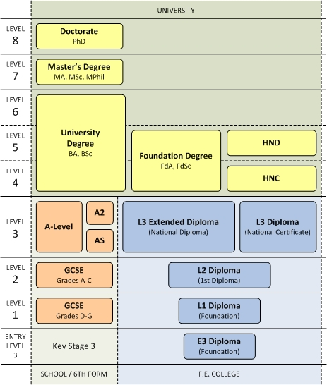
New Qualifications and Credit Framework (QCF) in the UK

Slide 11
The new pedagogical landscape: three areas of Provision

Slide 12
The complex pedagogical landscape
Blended degree education: three cycles
Online open education through OERs and MOOCs
Blended and online CPD, SLP’s and non-degree education
National
Transnational

Slide 13
Business models: a holistic approach
Regulated, fee paying
Non-regulated, diverse business models
In the public domain, open and for free, services paid

