Slide 1
Refugees and displaced people: what role can Open Universities play?
Dr. Liz Marr
EADTU summit, 15th April 2016

Slide 2

Each day, the role of the teacher is reinforced and its importance confirmed as the world questions what future we want for our children

Slide 3
Syrian Refugee crisis data
Breakdown of registered refugees per country (in region):
Turkey: 2,715,789
Lebanon: 1,067,785
Jordan: 636,040
Iraq: 246,051 (almost all in Kurdistan)
Egypt: 118,512
Libya: 28,027
In camps: 490,869
Out of camps: 4,321,335
Estimated 6.5m IDPs in Syria
Estimated 1.7m IDPs in camps or collective centres (in Damascus and Latakia)

Slide 4
Stranded migrants and refugees
As of 07/04/16 :
57,812 stranded migrants and refugees
in Greece, fYROM, Serbia, Croatia, Slovenia, Bulgaria and Hungary
Of 736 Syrians interviewed in Greece in February 16:
27% of all respondents are students,
14% over 18 who are students
Country | Number of stranded people
Greece | 53,063
fYROM | 1,151
Serbia | 932
Croatia | 111
Slovenia | 365
Bulgaria | 972
Hungary | 1,218

Slide 5
3RP NLG - No Lost Generation
New phase of the NLG aims to improve quality formal and non-formal learning opportunities for children and young people in the refugee host countries. This will be achieved by:
Scaling up equitable access to education in formal and non-formal settings.
Increasing demand for learning by engaging families and communities in the education of their children.
Improving the quality and relevance of education.
Strengthening national and sub-national education systems, including recognition and accreditation of formal and non-formal learning.

Slide 6
Why should HE matter?
‘Education strengthens the ties which bind people, takes the fear out of difference and encourages tolerance’
Baroness Kennedy, Learning Works, 1998

Slide 7
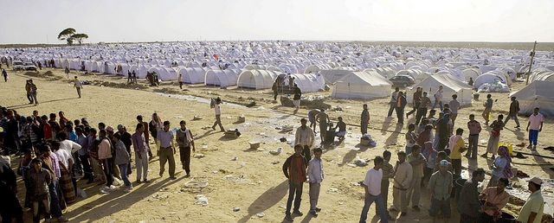
What are the barriers to HE access for refugees
Location and geography – in-country displacement, in camps, in Europe
Infrastructures
Lack of stability
Trauma, ill health,
disability
Money and employment
Prior attainment

Slide 8
How can Open Universities help?
Providing:
Mobile learning
Flexibility
Scalability
Open access and inclusion at core of missions
To support:
young students who missed secondary education
students who were in the middle of a university study
professionals who need conversion courses to find work now
pathways into other universities in Europe and in the region
specific education to rebuild the country
platforms/connections across Europe for diaspora to discuss educational futures
centres of excellence around specific subjects

Slide 9
Language Skills and Progression to HE
The Open University UK is working with The British Council to deliver academic programmes to displaced Syrian refugees who have temporarily settled in Jordan
BC provide coaching, study skills, an English Language programme and BC Online Academic Readiness Course
Students who reach required standards in English will be able to register on a OU course, others will be offered study through Arabic courses. All levels of qualification will be encouraged (Degrees, Diplomas etc)
MOOCs and other OERs will be made available to assist with readiness to study
Credit must be transferrable to other providers

Slide 10
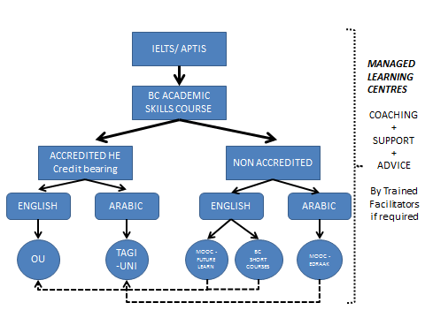
Study Model
Credit for previous HE study can be transferred in

Slide 11
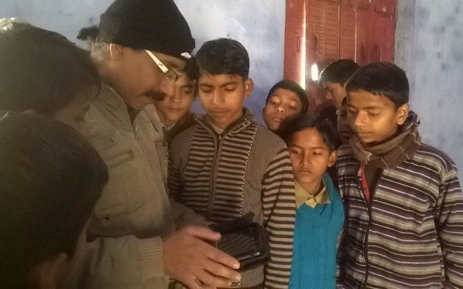
Teacher Education Through OERS and mobile devices
http://www.tess-india.edu.in/
http://www.open.ac.uk/about/international-development/ido-africa/TESSA
Provides adaptable OERs which can be downloaded onto mobile devices to support teacher education and class room development

Slide 12
The EADTU Proposition
Need for a specific long term cohesive cross sectoral European strategy to develop HE for refugees and displaced persons which:
Provides access to free courses for HE preparation, OERS, MOOCs, BOCs
Provides access to European language courses
Provides short, accredited conversion courses to meet European qualification equivalences
Provides short learning programmes which can be used as stepping stones into HE or as building blocks for qualifications
Provides vocational study programmes to support transition into employment in areas of skills gaps
Provides access to flexible degree and higher level study options
And does all this through flexible study modes, using mobile technologies, study centres in camps and trained support workers.

